Slide 1
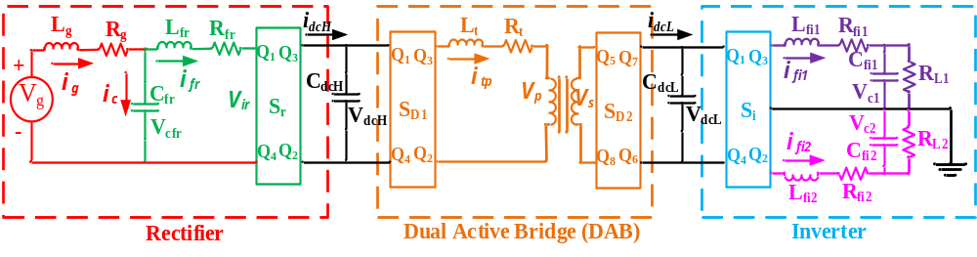
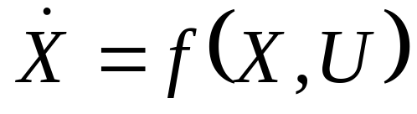


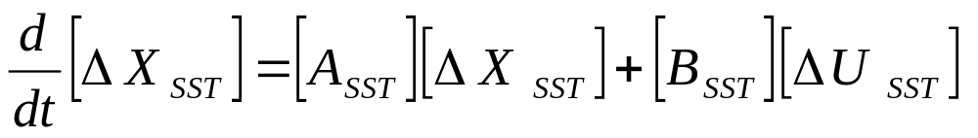
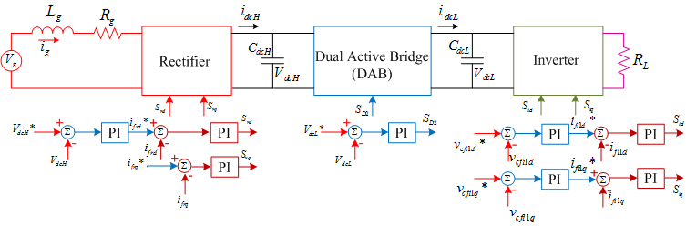
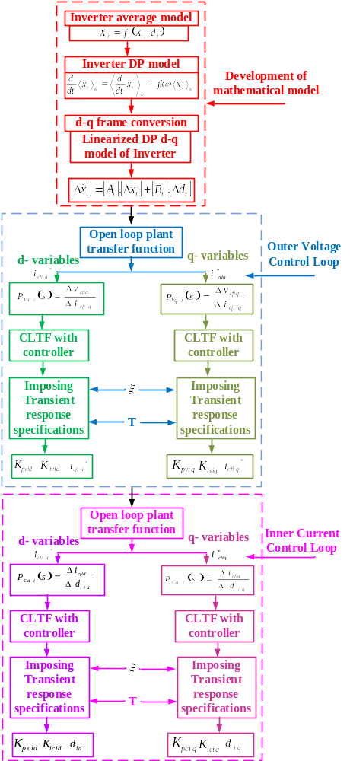
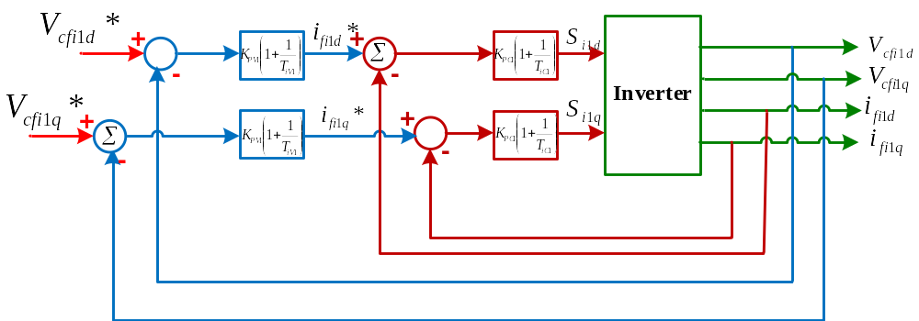
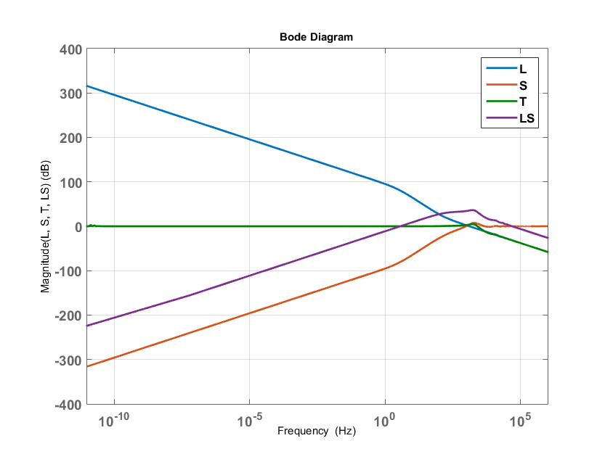
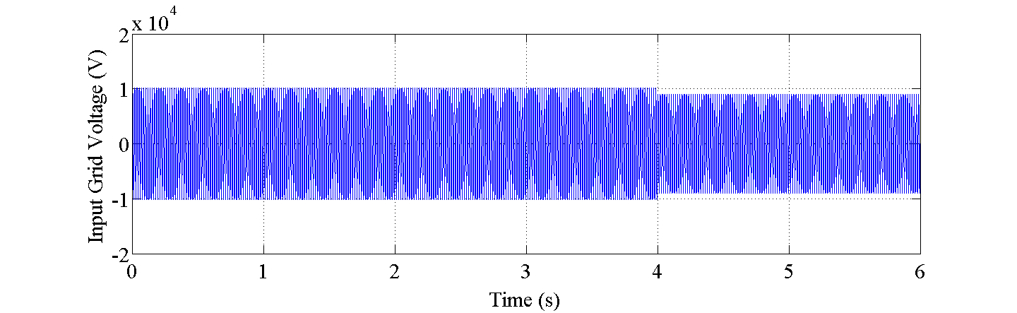
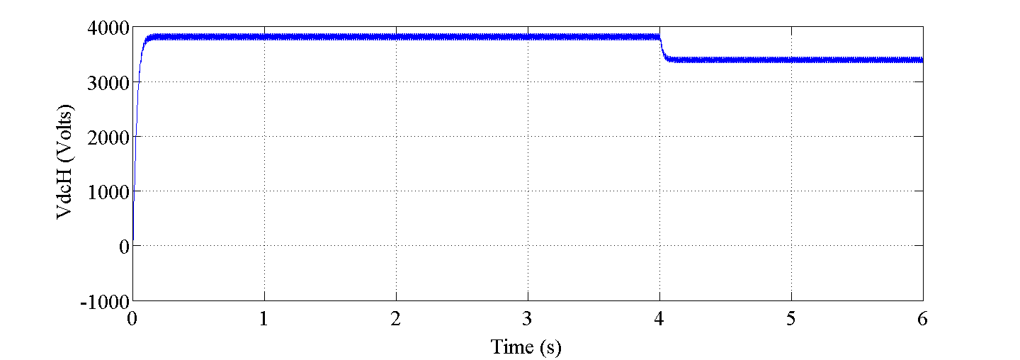
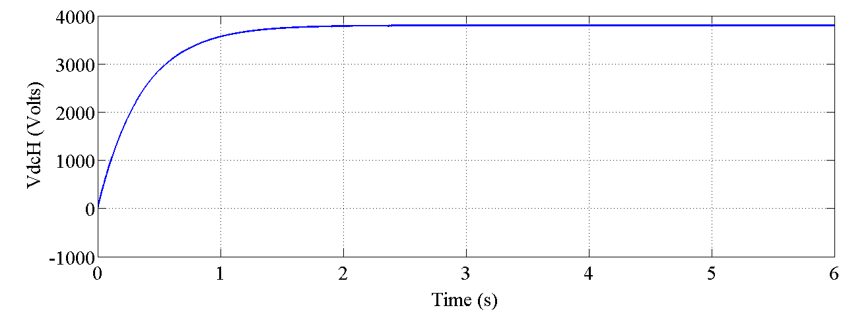
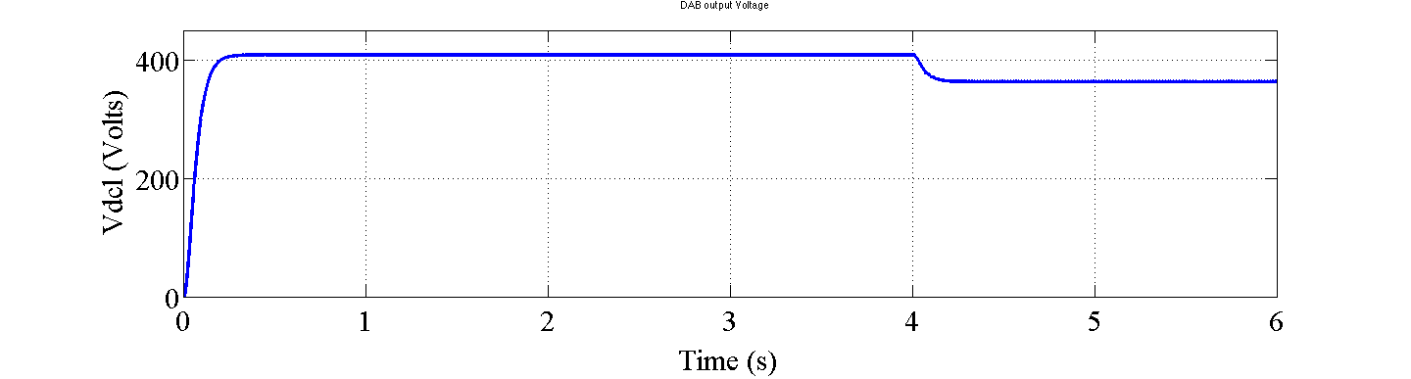
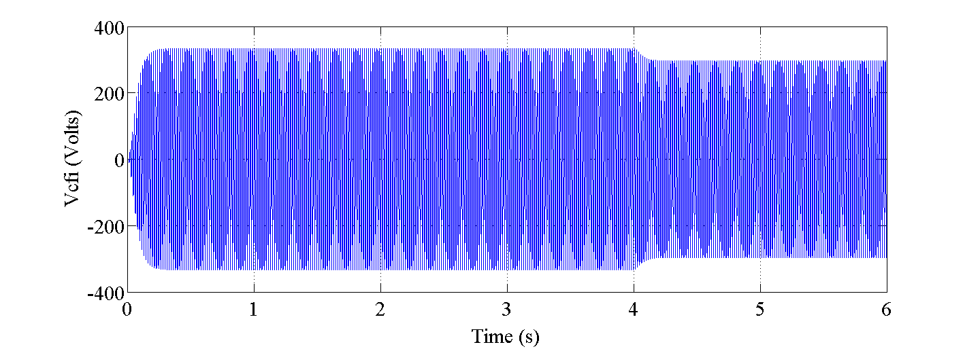
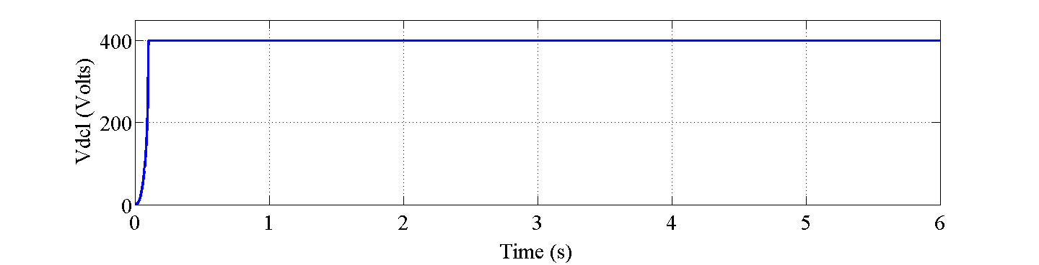
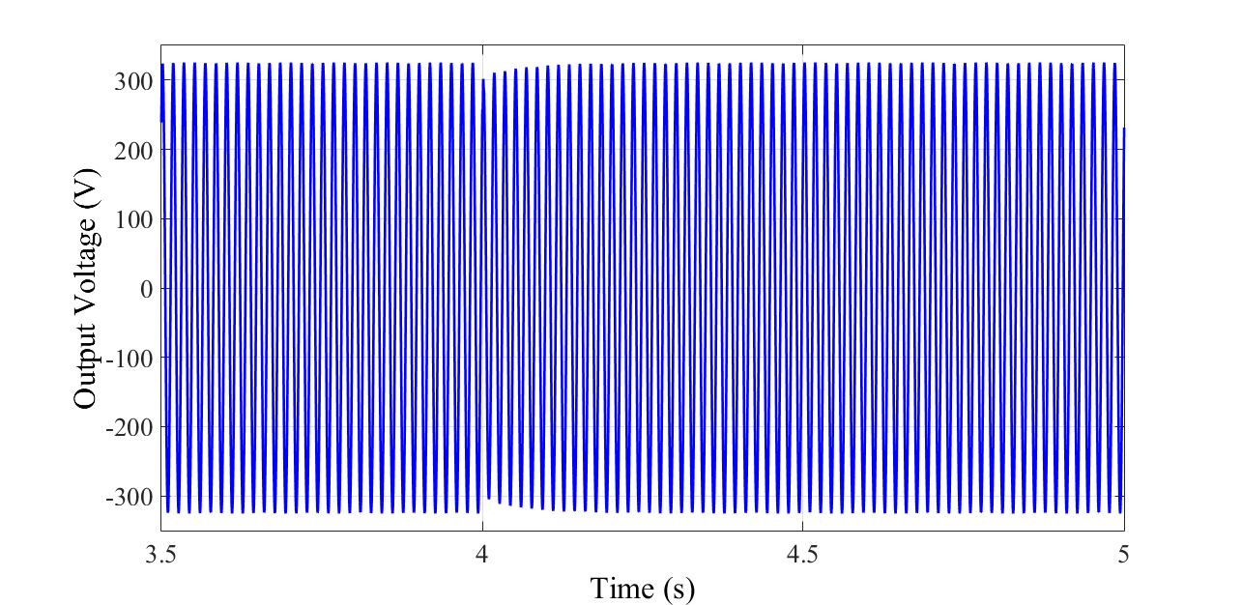
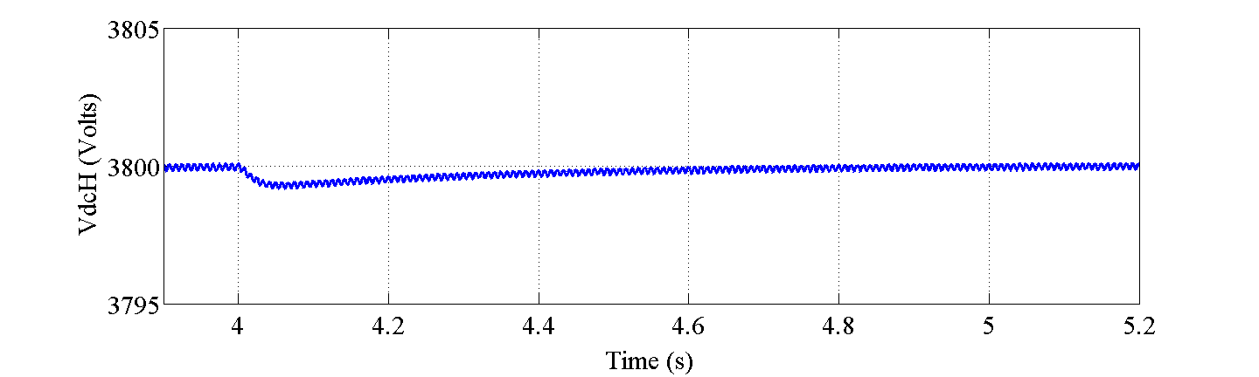
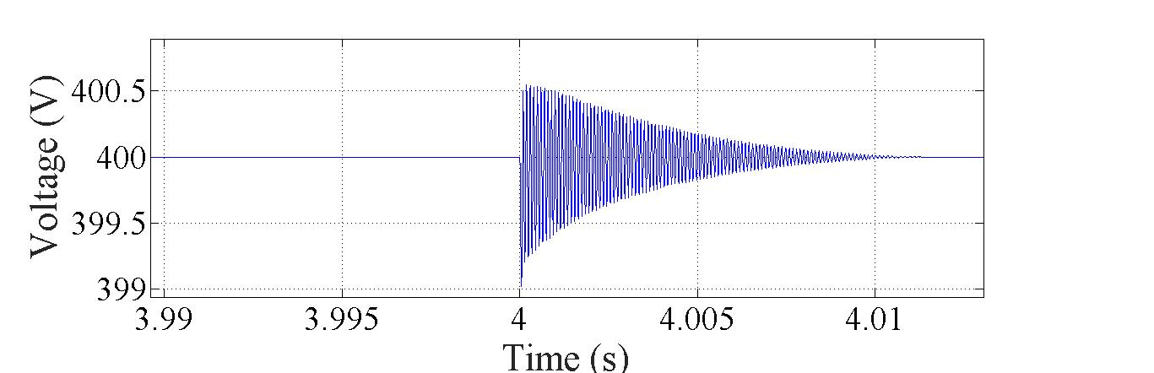
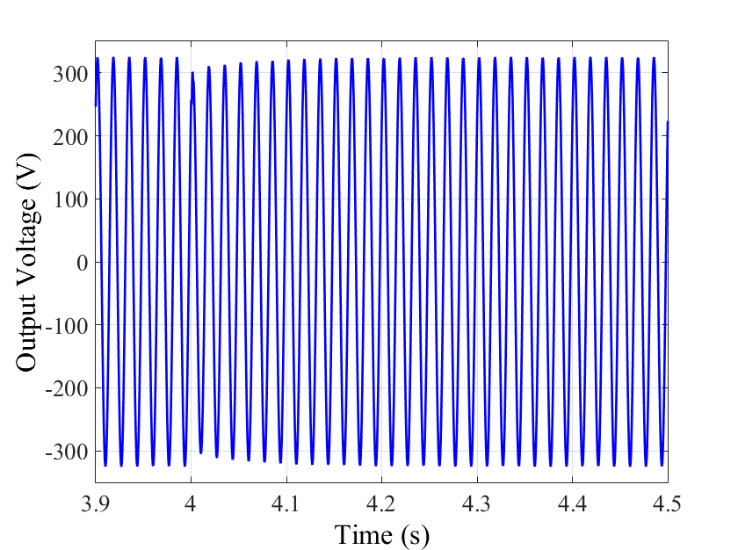
Y8.FS2.6: Dynamic Phasor-based Robust PI Control of Solid State Transformer
M Monika, R. Meshram, M Rane
S. Wagh and A. Stankovic Tufts University
Objective:
Robust PI controller design for SST using dynamic phasor model
(i) Linear Modular control over complex combined cascade control
(ii) DP-dq model for rectifier and inverter
(iii) Nested loop for rectifier and inverter
(iv) Direct voltage control for DAB
Fig. 1 Schematic representation of Solid state transformer (SST)
and
where, X- State variables, U- Switching functions
Technical Approach:
Loop shaping technique for PI controller design
Fig.2 Nested loop control scheme for inverter
Fig.3 Control scheme of 3-stage SST
Accomplishments:
Validation with simulation results:
With reference to Fig. 5:
High gain in low frequency region and low gain in high frequency region of loop transfer function shows the effective attenuation of load disturbances and measurement noise respectively.
The steep slope of the magnitude plot of loop transfer function around the crossover frequency indicates robustness of the controller.
The low gains of sensitivity and complimentary sensitivity transfer functions in low and high frequency regions respectively shows the effectiveness of the controller to the disturbances and noise.
The peak of the load sensitivity curve at crossover frequency gives the limit for the maximum value of the integral gain.
Fig. 5: Magnitude Plots for DAB showing effectiveness and robustness of controller
(a) Input grid voltage
(b) Rectifier response
(a) Input grid voltage
(b) Rectifier response
(a) Input grid voltage
Fig.4 Flow Diagram for inverter controller design
(c) DAB response
(d) Inverter response
(c) DAB response
(d) Inverter response
Fig.6 Uncontrolled response of the SST components
Fig.7 Controller response for input voltage variation
Next Steps:
Improvement in controller design
(a) Rectifier response
(b) ) DAB response
Considering the original nonlinear structure of the dynamic model, a nonlinear controller could be designed
Design of the controller which can deal with the negative impedance destabilizing characteristics of power electronic converters behave as constant power loads (CPLs)
Modification in controller design to support bidirectional power flow
Stability analysis with Model predictive controller
The issue of synchronization and voltage stability with multiple SST’s in a microgrid can be addressed through co-ordination of controllers
(c) Inverter response
Fig.8 Expanded view of Fig 7 controller response
Potential Impact:
Key Properties
Small signal DP-dq model for stages with AC/DC or DC/ AC interactions
Dq transformation to smoothen out small ripples in the output voltage waveform
Dq model facilitates control of active and reactive power components.
Loop shaping method for controller design
Nested loop with faster current control and slower voltage control
Combined control through the modular control
Robust control under parametric variations
DP-dq transformation allows use of PI over PR controller for inverter stage
Robust control design methods by exploiting simplicity of energy flow and dissipation as a basis for effective design
Port-controlled Hamiltonian descriptions with hierarchical, multi-scale modeling at different levels of abstraction.

